Slide 1
Python week 3
Canberra Chinese School Sem3

Slide 2

list comprehension (review)
The general structure of list comprehension is:
new_list = [expression for item in old_list]

Slide 3
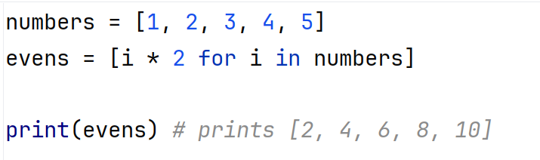
list comprehension
The general structure of list comprehension is:
new_list = [expression for item in old_list]
Example:

Slide 4
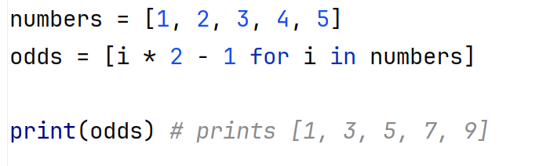
list comprehension
The general structure of list comprehension is:
new_list = [expression for item in old_list]
Example:

Slide 5
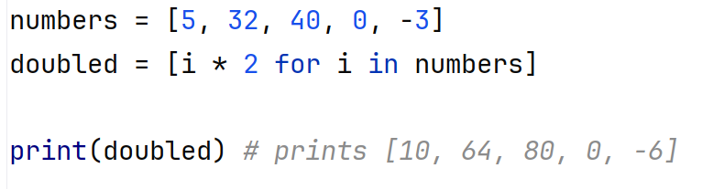
list comprehension
Some more examples:

Slide 6
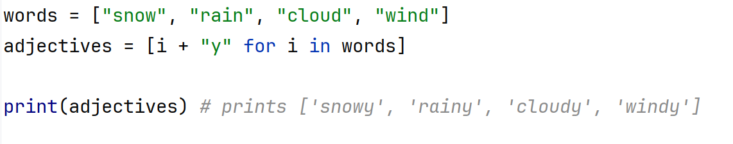
list comprehension
Some more examples:

Slide 7
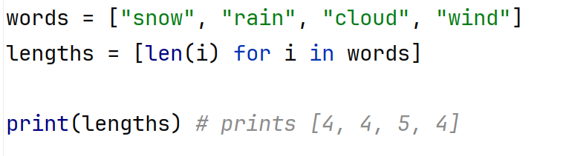
list comprehension
Some more examples:

Slide 8
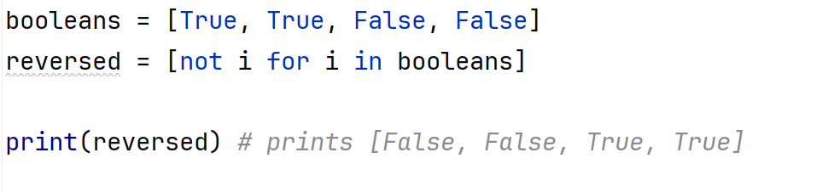
list comprehension
Some more examples:

Slide 9
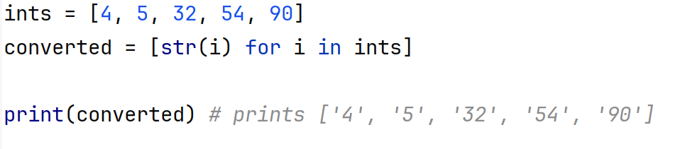
list comprehension
Some more examples:

Slide 10
list comprehension
Exercise: you are given this list
Write a script that creates a list containing all the words in this list, but uppercased.
Hint: if name is a string, then name.upper() gives the name in uppercase

Slide 11
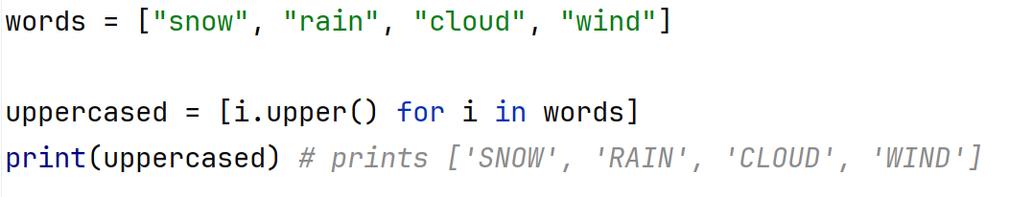
list comprehension
Exercise: you are given this list
Write a script that creates a list containing all the words in this list, but uppercased.

Slide 12
list comprehension
Exercise: you are given a list of colours
colours = [“green", "yellow", “red", “blue"]
Write a script that creates a list of 25 random colours chosen from this colours list, using the short method of list comprehension we learned today.

Slide 13
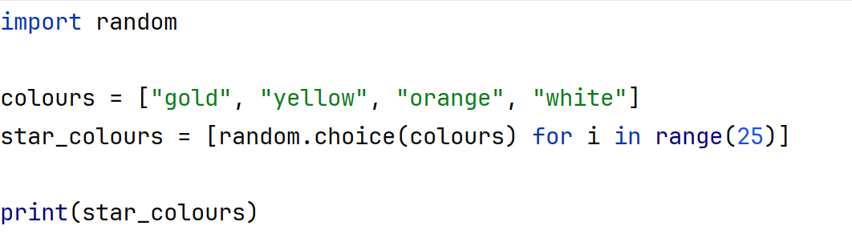
list comprehension
Exercise: you are given a list of colours
colours = [“green", "yellow", “red", “blue"]
Write a script that creates a list of 25 random colours chosen from this colours list, using the short method of list comprehension we learned today.

Slide 14
list comprehension
The structure of list comprehension can also contain a logical statement:
new_list = [expression for item in old_list if condition]

Slide 15
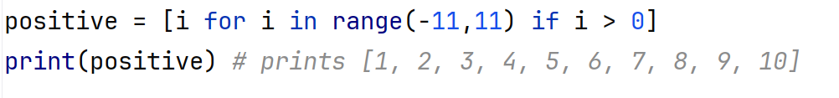
list comprehension
The structure of list comprehension can also contain a logical statement:
new_list = [expression for item in old_list if condition]
Example:

